Slide 1
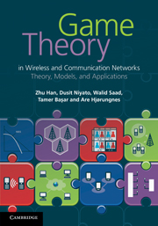
Game Theory in Wireless and Communication Networks: Theory, Models, and Applications
Lecture 6
Auction Theory
Zhu Han, Dusit Niyato, Walid Saad,
Tamer Basar, and Are Hjorungnes

Slide 2
Overview of Lecture Notes
Introduction to Game Theory: Lecture 1, book 1
Non-cooperative Games: Lecture 1, Chapter 3, book 1
Bayesian Games: Lecture 2, Chapter 4, book 1
Differential Games: Lecture 3, Chapter 5, book 1
Evolutionary Games: Lecture 4, Chapter 6, book 1
Cooperative Games: Lecture 5, Chapter 7, book 1
Auction Theory: Lecture 6, Chapter 8, book 1
Matching Game: Lecture 7, Chapter 2, book 2
Contract Theory, Lecture 8, Chapter 3, book 2
Learning in Game, Lecture 9, Chapter 6, book 2
Stochastic Game, Lecture 10, Chapter 4, book 2
Game with Bounded Rationality, Lecture 11, Chapter 5, book 2
Equilibrium Programming with Equilibrium Constraint, Lecture 12, Chapter 7, book 2
Zero Determinant Strategy, Lecture 13, Chapter 8, book 2
Mean Field Game, Lecture 14, book 2
Network Economy, Lecture 15, book 2
[<number>]

Slide 3
Outline
Introduction and auction basics
Mechanism design
Special auctions
  VCG auction
  Share auction
  Double auction
  Sequential first-price auction
  AGV auction
  Ascending clock auction
  (Reverse) combinatorial auction
Auction theory in spectrum sharing
Summary
[<number>]

Slide 4
Introduction
A market mechanism in which an object, service, or set of objects, is exchanged on the basis of bids submitted by participants.
An auction provides a specific set of rules that will govern the sale or purchase (procurement auction) of an object to the submitter of the most favorable bid.
Typical auctions
  First-price auction
  Second-price auction
  English auction
  Dutch auction
  Japanese auction
  All-pay actions
  Unique bid auction
  Generalized second-price auction
[<number>]

Slide 5
Properties of Auctions
Allocative efficiency means that in all these auctions the highest bidder always wins (i.e., there are no reserve prices).
It is desirable for an auction to be computationally efficient.
Revenue Equivalence Theorem: Any two auctions such that:
  The bidder with the highest value wins
  The bidder with the lowest value expects zero profit
  Bidders are risk-neutral 1
  Value distributions are strictly increasing and atomless
have the same revenue and also the same expected profit for each bidder. The theorem can help find some equilibrium strategy.
[<number>]

Slide 6
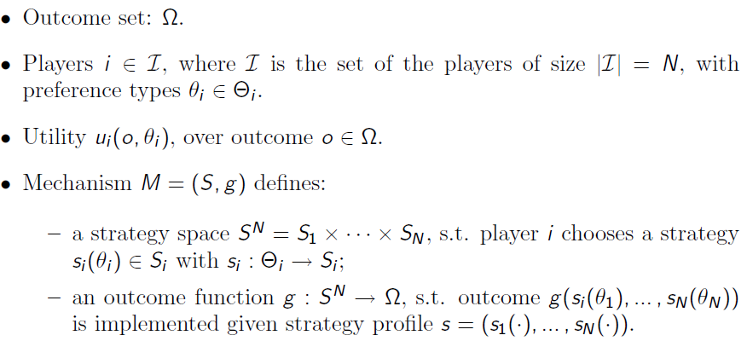
Mechanism Design
Definition of Mechanism
[<number>]

Slide 7

Design goal and properties
The objective of a mechanism M = (S, g) is to achieve the desired game outcome
Desired properties
  Efficiency: select the outcome that maximizes total utility.
  Fairness: select the outcome that achieves a certain fairness criterion in utility.
  Revenue maximization: select the outcome that maximizes revenue to a seller (or more generally, utility to one of the players).
  Budget-balanced: implement outcomes that have balanced transfers across players.
  Pareto optimality
[<number>]

Slide 8
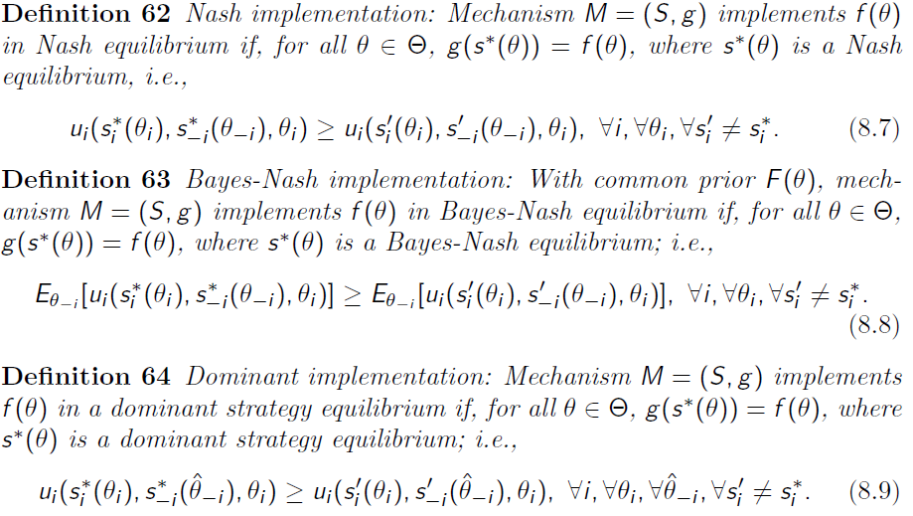
Equilibrium concepts
[<number>]

Slide 9
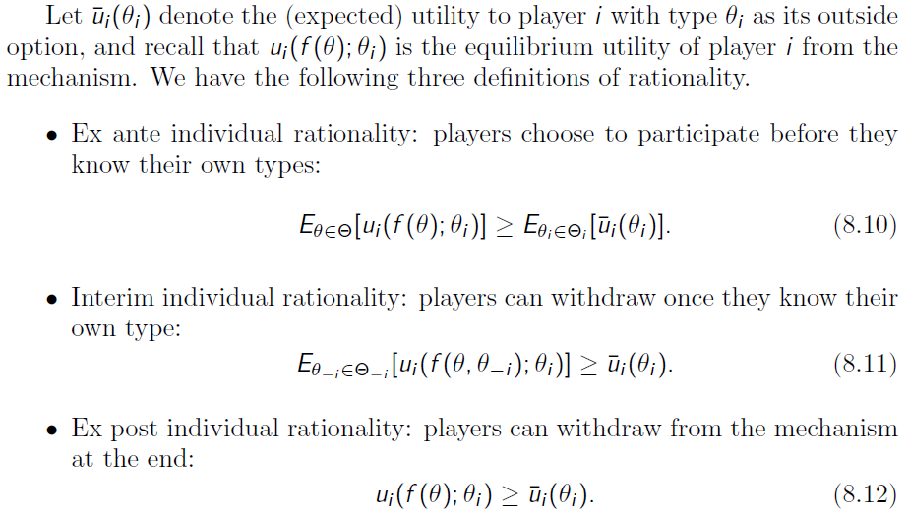
Rationality Concepts
[<number>]

Slide 10
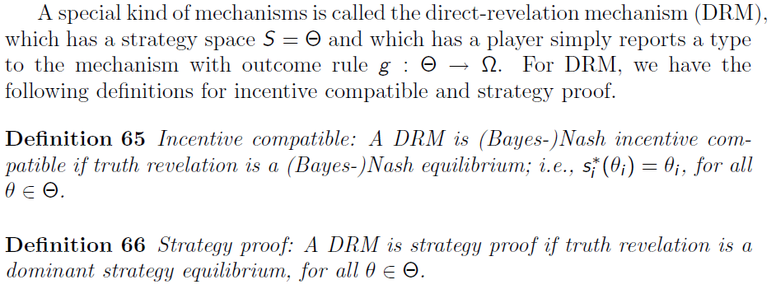
DRM, Incentive Compatible and Strategy Proof
[<number>]

Slide 11
Revelation Principle
For any Bayesian Nash equilibrium there corresponds a Bayesian game with the same equilibrium outcome but in which players truthfully report type.
Allows one to solve for a Bayesian equilibrium by assuming all players truthfully report type (subject to an incentive-compatibility constraint), which eliminates the need to consider either strategic behavior or lying.
no matter what the mechanism, a designer can confine attention to equilibria in which players truthfully report type.
Theorem: For any mechanism, M, there is a direct, incentive-compatible mechanism with the same outcome.
  Incentive compatible is free
  Fancy mechanisms are unnecessary
[<number>]

Slide 12
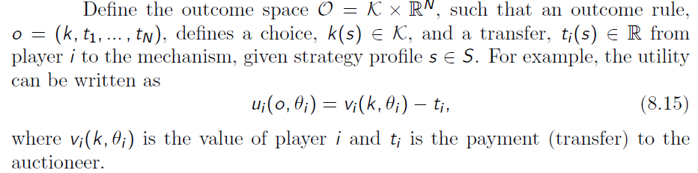

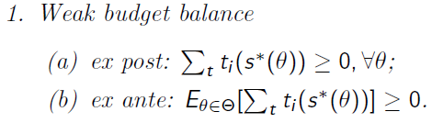
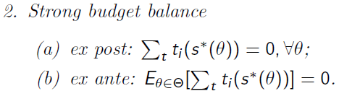
Budget Balance
Transfer or side payment
Budget balance
[<number>]

Slide 13
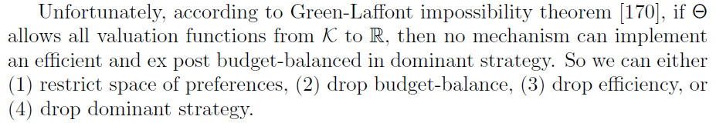
Efficiency
[<number>]

Slide 14
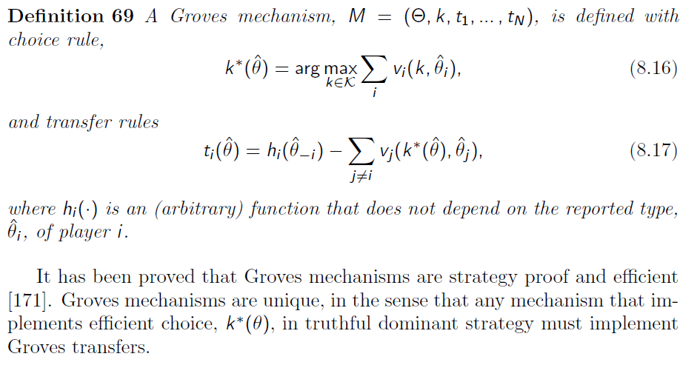
Groves Mechanisms
[<number>]

Slide 15
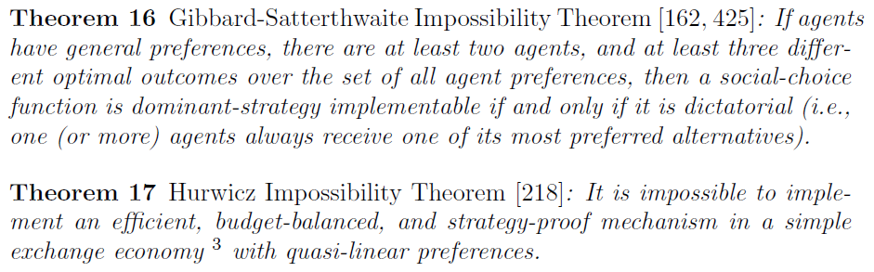
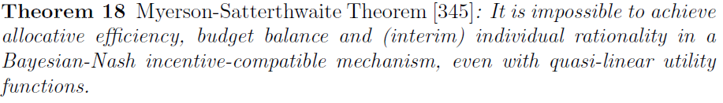
Impossibility and Possibility
[<number>]

Slide 16
Outline
Introduction and auction basics
Mechanism design
Special auctions
  VCG auction
  Share auction
  Double auction
  Sequential first-price auction
  AGV auction
  Ascending clock auction
  Reverse combinatorial auction
Summary
[<number>]

Slide 17
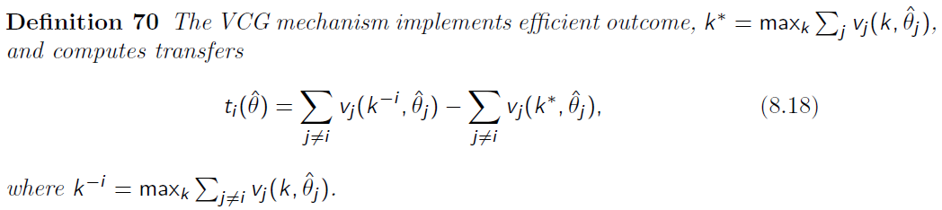
VCG Auction
Vickrey auction is a type of sealed-bid auction, in which bidders (players) submit written bids without knowing the bid of the other people in the auction. The highest bidder wins, but the price paid is the second-highest bid.
In other words, the payment equals to the performance loss of all other users because of including user i .
Truthful relevance, ex post efficient, and strategy proof
[<number>]

Slide 18
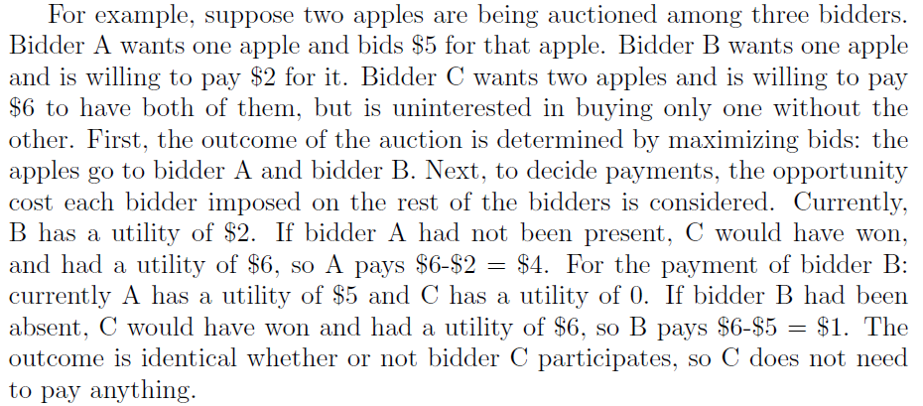
VCG Example
[<number>]

Slide 19
Shortcoming of VCG
It does not allow for price discovery - that is, discovery of the market price if the buyers are unsure of their own valuations - without sequential auctions.
Sellers may use shill bids to increase profit.
In iterated Vickrey auctions, the strategy of revealing true valuations is no longer dominant.
It is vulnerable to collusion by losing bidders.
It is vulnerable to shill bidding with respect to the buyers.
It does not necessarily maximize seller revenues; seller revenues may even be zero in VCG auctions. If the purpose of holding the auction is to maximize profit for the seller rather than just allocate resources among buyers, then VCG may be a poor choice.
The seller's revenues are non-monotonic with regard to the sets of bidders and offers.
[<number>]

Slide 20
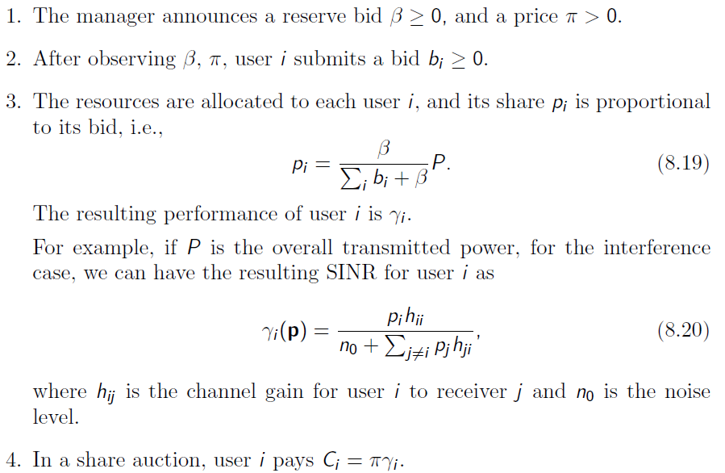
Share Auction
A share auction is concerned with allocating a perfect divisible good among a set of bidders.
Share Auction Mechanism:
[<number>]

Slide 21
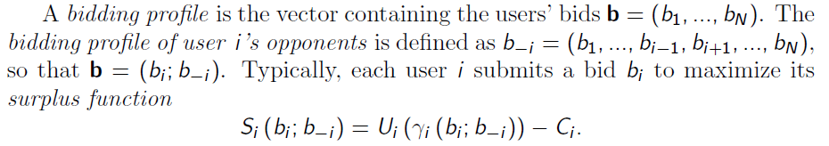
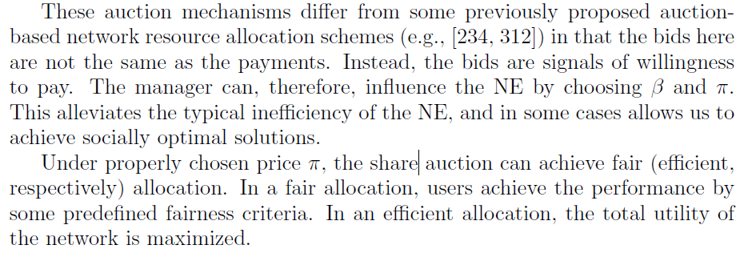
Share Auction
[<number>]

Slide 22
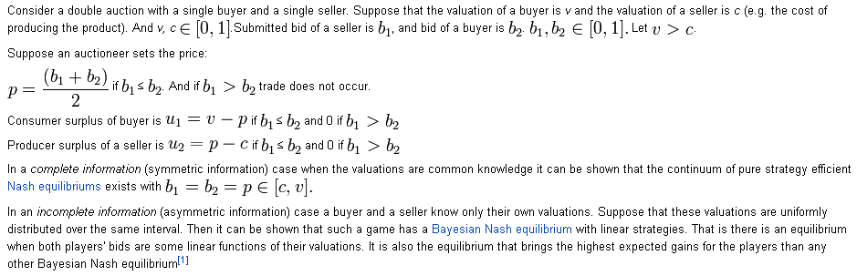
Double Auction
A double auction is a process of buying and selling goods when potential buyers submit their bids and potential sellers simultaneously submit their ask prices to an auctioneer, and then an auctioneer chooses some price p that clears the market: all the sellers who asked less than p sell and all buyers who bid more than p buy at this price p.
[<number>]

Slide 23


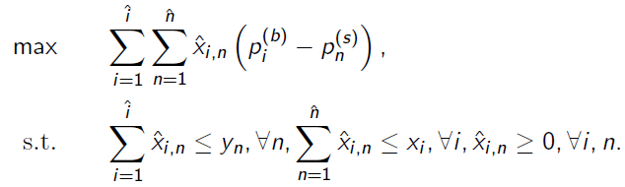
Double Auction
Buyer utility
Seller utility
Optimization
[<number>]

Slide 24
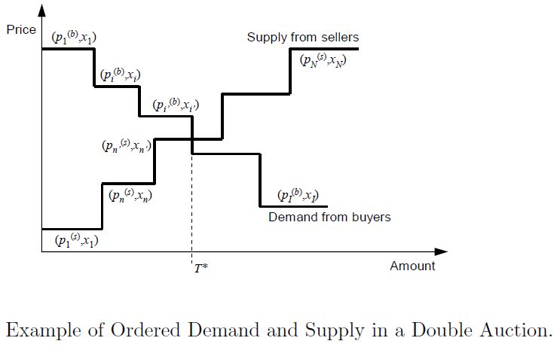
Double Auction
[<number>]

Slide 25
Sequential First/Second-Price Auction
In multi-object auctions, multiple objects are put up for auction and multiple winners emerge.
  substitutable auctions: different objects have same value for specific bidder.
  non-substitutable auctions: the values of different objects are different
The winners of the items sequentially decided in multiple rounds. In each round, each bidder can submit only one bid for a specific object and only the winners of the bided items are decided.
Sequential auctions require less information exchange among the auctioneer and bidders, and provide high flexibility for the bidders and high revenue for the auctioneer.
[<number>]

Slide 26
Sequential First/Second-Price Auction
The sequential first price auction is a situation in which the M object are sold to N > M bidders using a series of first-price sealed bid auctions.
  Specifically, in each round, each bidder bids for a specific item, and for each item that is bided by at least one bidder, the item is obtained by the bidder with the highest bid at the price of its submitted bid.
The only difference for the sequential second price auction is that, in each round, the winner obtains the item at the price of the second highest bid, instead of its submitted bid.
[<number>]

Slide 27
AGV Auction
AGV(Arrow-d’Aspremont-Gerard-Varet) mechanism is an extension of the Groves mechanism,
  Incentive Compatibility, Individual Rationality and Budget Balance
  “Expected form” of the Groves mechanisms
  The allocation rule is the same as VCG.
[<number>]

Slide 28
Ascending Clock Auction
During the auction, the auctioneer first announces a initial price, then the bidders report to the auctioneer their demands at that price, and the auctioneer raises the price until the total demands meet the supply.
  Distributed approach
  Single object pay-as-bid ascending clock auction, in which the good is sold as a single object and the bidder can only bid 0 or p
  Traditional ascending clock auction, where each bidder is allowed to bid between 0 and p at every iteration. Distributed dual-based optimization approach for Network Utility Maximization problem
[<number>]

Slide 29
(Reverse) Combinatorial Auction
Combinatorial auctions (CAs) are multi-item auctions in which bidders can place bids on combinations of items called packages or bundles, rather than just on individual item.
  Pricing and bidding strategies
  Winner determination problem
Reverse CA game
  The auctioneer first announces an initial price
  The bidders submit bids corresponding to the current price
  A bidder should determine a bid for every package he is interested in.
  The auctioneer collects bids and finds the highest utility. If the highest utility is non-negative, the auctioneer is willing to sell the items, otherwise, he will not sell them.
  Then the auctioneer reduces the price and the auction moves to the next round.
  When stopping rules are satisfied, the auction is concluded.
[<number>]

Slide 30
Auction Types
bids
ask
Seller
Sellers
Demand
Auction
Supply
Auction
Buyers
Buyer
asks
bids
Sellers
Double
Auction
Buyers
IEEE ICC'10

Slide 31
Auction and Spectrum Management
Theory of auction can be applied to the problem of spectrum access and sharing (i.e., spectrum trading)
Seller: spectrum owner,
primary user
Demand Auction
Spectrum bids
…
Buyers: service providers,
cognitive radio users
IEEE ICC'10

Slide 32
Auction and Spectrum Management
Joint competitive spectrum bidding and service pricing in IEEE 802.22 networks [SM33]
  Sellers: spectrum owner (i.e., TV broadcasters)
  Buyers: IEEE 802.22 network service providers
IEEE ICC'10

Slide 33

System Model
Pool of TV bands
Spectrum trading
Area 2
Area 1
Area 3
802.22 BS1
802.22 BS2
IEEE ICC'10
Notes:
In the system model under consideration, there are many TV broadcasters selling TV bands to 802.22 service providers who operates 802.22 base stations. These base station provides broadband services to 802.22 users. 802.22 users are charged by a certain price for using the broadband service from 802.22 service providers. Note that for the rest of presentation, service provider refers to 802.22 service provider and user refers to 802.22 users for brevity.

Slide 34
Problem Formulation
TV broadcasters
Trading price
Selling spectrum
(Exclusive-use model)
Number of TV bands to bid
WRAN
service providers
Service price, bandwidth
Selling service
Number of users
choosing each service
WRAN users
How to obtain the solutions?
IEEE ICC'10
Notes:
Based on the system model, the problem formulation is defined as follows. There are three types of entities in the system. The TV broadcaster sells TV bands to 802.22 service providers based on exclusive-use spectrum access model. In this case, the trading price of TV broadcaster and the number of TV bands to bid by 802.22 service providers have to be determined. Then, after obtaining TV band, 802.22 service provider sells the broadband service to the users. In this case, the service price and bandwidth have to be determined by service provider. Here, since there are multiple broadband services available, the users can choose the best service providers according to the price and performance. This will determine the number of users choosing each service. Then, the problem here is that how to obtain the equilibrium solutions for this spectrum trading model.

Slide 35
Problem Formulation
Double auction
TV broadcasters
Spectrum bidding
and service pricing
WRAN
service providers
Service selection
(churning)
WRAN users
IEEE ICC'10
Notes:
Here, I propose hierarchical spectrum trading model. In the first level, the trading price of tv band selling by TV broadcasters is determined by double auction. In the second level, the spectrum bidding and service pricing scheme is proposed for service provider to determine the number of TV bands to bid and the price of service charging to the users. In the third level, the service selection scheme is used by the users to capture the churning behavior.

Slide 36
Game Model Formulations
Double auction
Trading price
TV broadcasters
Number of
bidding TV bands
Spectrum bidding
and service pricing
Noncooperative
game
WRAN
service providers
Number of users
choosing each service
Service price
Service selection
(churning)
Evolutionary
game
WRAN users
IEEE ICC'10
Notes:
For this hierarchical spectrum trading formulation, game theoretic framework is proposed. The service selection for the users is developed based on evolutionary game model. The spectrum bidding and service pricing is developed based on noncooperative game model.

Slide 37
Double Auction
TV broadcasters
Double auction
WRAN
service providers
Double auction is established among TV broadcasters (i.e., sellers) and WRAN service providers (i.e., buyers)
Price of TV band is varied
The market structure is for multiple-seller and multiple-buyers
IEEE ICC'10
Notes:
Based on the equilibrium service price, then the service provider has to determine the number of TV bands to bid. Here, the bidding follows double auction rule. Double auction is applied between the seller which are TV broadcasters and the buyers which are service providers since the price of tv band is varied and undertermined. Also, there are multiple sellers and multiple buyers. Therefore, double auction is the suitable framework to obtain trading price for tv bands in this market structure.

Slide 38
Double Auction
Example
Offering price
15
18
10
20
Double auction
Number of TV bands to bid for
IEEE ICC'10
Notes:
Here, I would like to show the specific example of double auction. There are 4 TV broadcasters selling the TV band by offering prices 10, 15, 18, and 20. Two service providers chooses the number of TV bands to bid for.

Slide 39
Summary
Auctions take many forms but always satisfy two conditions:
  They may be used to sell any item and so are universal, also
  The outcome of the auction does not depend on the identity of the bidders; i.e., auctions are anonymous.
Properties
  efficiency of a given auction design
  optimal and equilibrium bidding strategies
  revenue comparison.
Winner curse
  winner will frequently have bid too much for the auctioned item.
Many applications in wireless networking
[<number>]

